Slide 1


Characterization 2
Character Traits
© 2025 Geoffrey James Aguirre. All Rights Reserved.

Slide 2
Characterization 2 | Videos

Slide 3
Characterization 2: Static Traits versus Dynamic Trait Pairs; Confusers

Slide 4
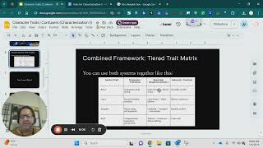

Slide 5
Mr. A Reads (and Analyzes Character Traits in) Wolfina’s First Day at Farmington High

Slide 6
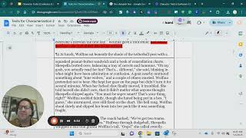

Slide 7
Wolfina’s First Day at Farmington High
¶1 | “[H]er paws clutched around a school map already worn at the corners” (¶1). “She scanned her schedule for the third time” (¶1). | “Wolfina nodded but said nothing, pressing her tail around her leg like a rope” (¶1).
¶2 | “She kept her gaze on the page but didn’t turn it for several minutes” (¶2). “[She] slipped her book into her pack like it was something fragile” (¶2). | “Wolfina pretended not to hear she murmured, eyes still fixed on the chart” (¶2).
¶3 | “[She] stared at the red rubber ball that had rolled to her feet” (¶3). “She rolled her shoulders once, shook out her wrist, and reset her stance” (¶3). | “‘You missed,’ she said calmly” (¶3). “Then, without a word, she pivoted and sent the ball flying” (¶3). “Sheepella blinked. ‘Whoa’” (¶3).
 | Static Trait | Dynamic Trait Pair
 | Thoughtful (or Observant, Prepared, Careful) | Conflict-Avoidant→Assertive

Slide 8
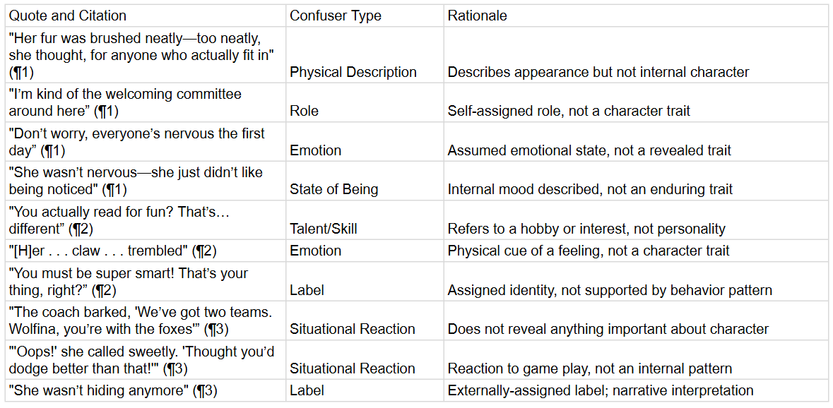
Wolfina’s First Day at Farmington High

Slide 9
Traits | Degree, Nuance, and Interrelatedness

Slide 10
Example: Brave
Anchor Trait: Brave
Synonyms: courageous, fearless, daring
Close Synonyms (with nuance): resolute, bold, spirited
Related-but-different: reckless (similar behavior, different motivation)
Traits as Anchor Terms with Synonyms (Trait Clusters)

Slide 11
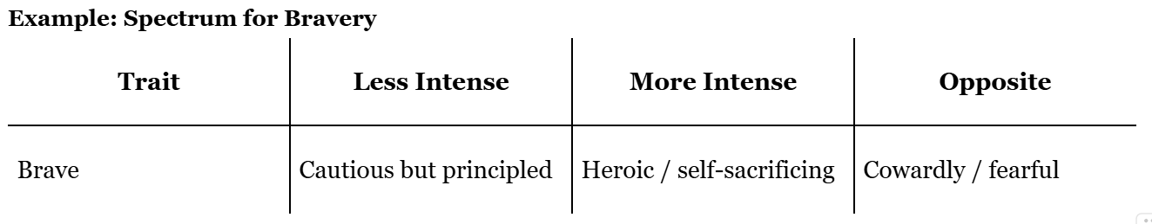
Traits as Conceptual Spectrums (With Antonyms and Degrees)

Slide 12
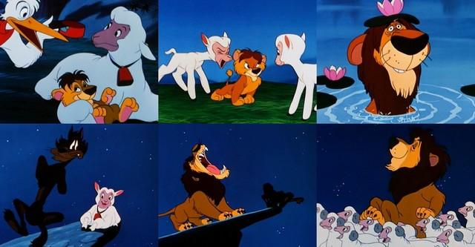


Slide 13
STATIC Trait
DYNAMIC Trait
Static versus Dynamic Traits
Beginning
Beginning
Middle
Middle
Transformative Moment
Transformative Moment
End
End
Textual evidence (STEAL) shows the character exhibiting the trait consistently throughout the story.
Textual evidence (STEAL) shows the character exhibiting the trait throughout much of the story, but exhibiting an opposing trait after one or more transformative moments..
Trait is indirectly shown through STEAL
Trait is indirectly shown through STEAL
Trait is indirectly shown through STEAL
Trait is indirectly shown through STEAL
Trait is indirectly shown through STEAL
One or more transformative moments indicate the trait is confronted and altered
Trait is indirectly shown through STEAL
A contrasting trait is indirectly shown through STEAL

Slide 14
Static Character | Dynamic Character
Stays the same | Changes or grows
Easier to describe | Harder to describe, but deeper
Example: Curley (Of Mice and Men) – always aggressive | Example: Lizabeth (Marigolds) – grows from confused to thoughtful
Static Character | Dynamic Character
Traits remain consistent throughout | Traits shift or evolve meaningfully
Easier to label traits | Must track trait change over time
Often symbolic or archetypal | Often realistic or complex
Curley in Of Mice and Men – consistently aggressive | Lizabeth in Marigolds – grows from confused to reflective

Slide 15
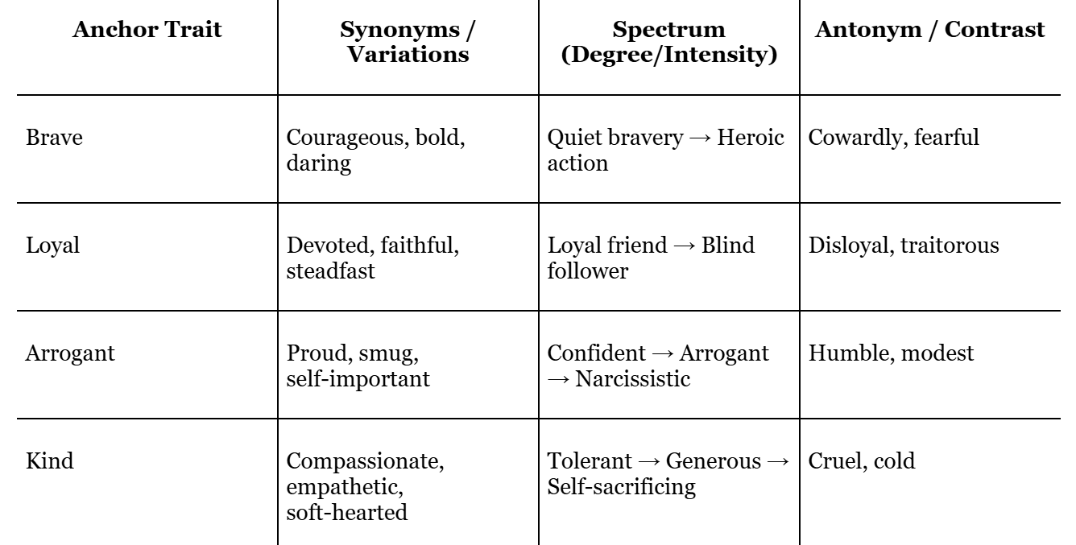
Combined Framework: Tiered Trait Matrix
You can use both systems together like this:

Slide 16
Traits | versus Confusers

Slide 17
Consistent – It shows up across time or in more than one situation.
A trait is:
Patterned – It reflects a tendency in how the character typically thinks, feels, or behaves.
Evidence-Based – It can be supported by observable examples (speech,thoughts, actions, and so on).
Psychologically Revealing – It gives insight into what kind of person the character is.
01
02
03
04
© 2025 Geoffrey James Aguirre. All Rights Reserved.

Slide 18
Impostors = Almost a trait, but fails when tested
Confusers = Not traits at all (even if they seem like it)
© 2025 Geoffrey James Aguirre. All Rights Reserved.

Slide 19
A trait confuser . . .
. . . is a category of character description that students often mistake for traits, but they never qualify on their own.
They don’t even make it to the “test” phase unless misunderstood.
01
02
03
04
© 2025 Geoffrey James Aguirre. All Rights Reserved.

Slide 20
Roles/Labels (“leader,” “the smart one,” “best friend”)
Trait confuser types
Skills/Talents (good memory, fast runner, good cook)
States of Being (tired, sick, cold, hungry)
(external, temporary, or shallow descriptions)
Emotions (angry, happy, nervous)
Situational Reactions (flinched once, ran once, yelled once)
© 2025 Geoffrey James Aguirre. All Rights Reserved.

Slide 21
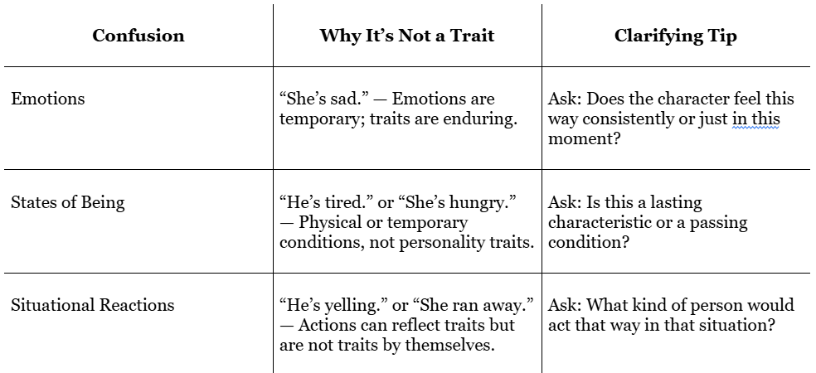
Confusers
Traits are often confused with other types of descriptions:

Slide 22
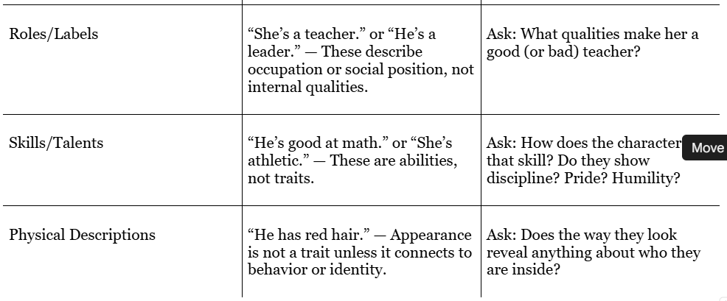
Confusers
Traits are often confused with other types of descriptions:

